Slide 1
Semi-supervised event classification
Preliminary results

Slide 2
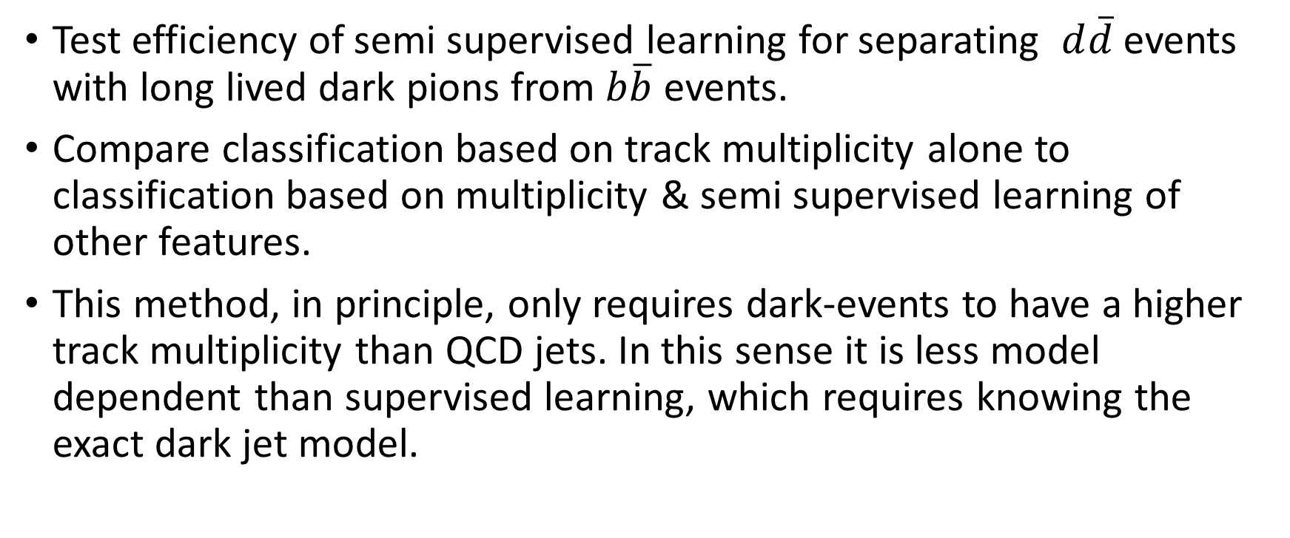
Goal
Test efficiency of semi supervised learning for separating $d\overline{d}$ events with long lived dark pions from $b\overline{b}$ events.
Compare classification based on track multiplicity alone to classification based on multiplicity & semi supervised learning of other features.
This method, in principle, only requires dark-events to have a higher track multiplicity than QCD jets. In this sense it is less model dependent than supervised learning, which requires knowing the exact dark jet model.

Slide 3
Method
A dataset of background and signal events.
Separate events to background-rich group and signal-rich group using the output of a weak classifier on k jets within the event.
Train classifier to distinguish between the two groups using the features of the remaining jets.
The degree of model independence limits the “strength” of the weak classifier.
Correlation between the inputs of the classifiers prevents from the second classifier to improve on the first one.

Slide 4
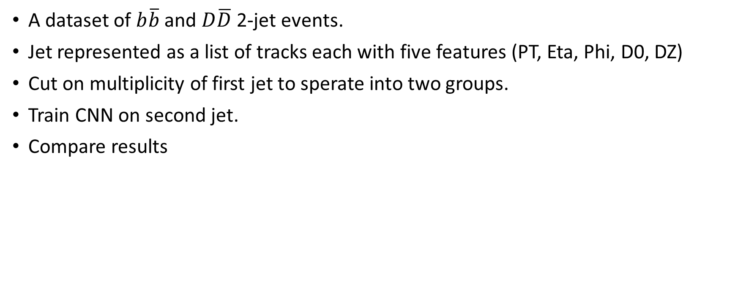
Implementation
A dataset of $b\overline{b}$ and $D\overline{D}$ 2-jet events.
Jet represented as a list of tracks each with five features (PT, Eta, Phi, D0, DZ)
Cut on multiplicity of first jet to sperate into two groups.
Train CNN on second jet.
Compare results

Slide 5

N = 75,000 events
Signal
Background
Signal fraction = $\frac{S}{S+B}$
First classifier
Frac1
Frac2
Second classifier
Signal
Background
The classification performance is governed by the signal fraction in the latent groups Frac1 and Frac2.
These are controlled by Signal fraction and the signal and background efficiencies of the first classifier.
If the signal fraction is very high then further classification isn’t necessary.
If the signal fraction is too low then the second classifier will struggle to distinguish signal from background.

Slide 6
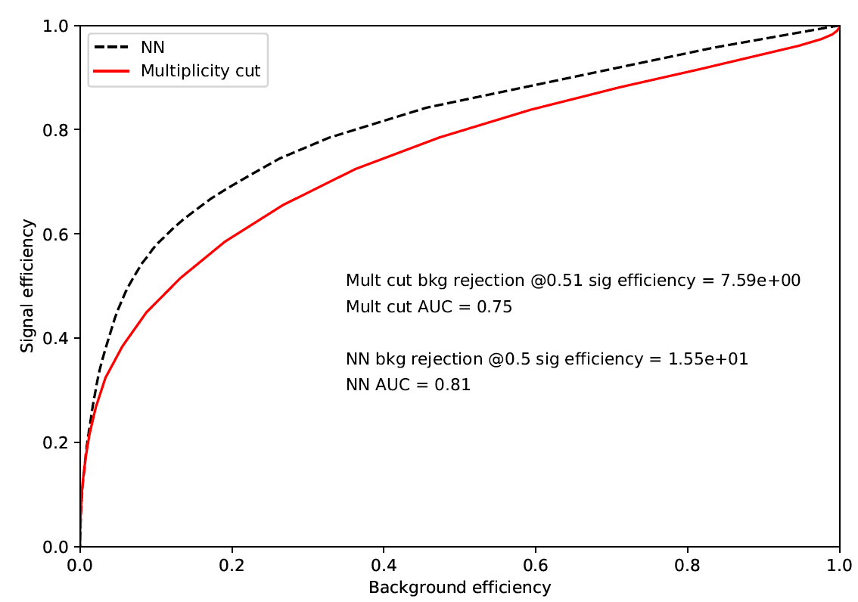
S
B
Frac1 = 40%
Frac2 = 13%
Model | LSTM
Signal fraction | 0.2
Multiplicity threshold | 15
Number of constituents | 40 (masked)

Slide 7
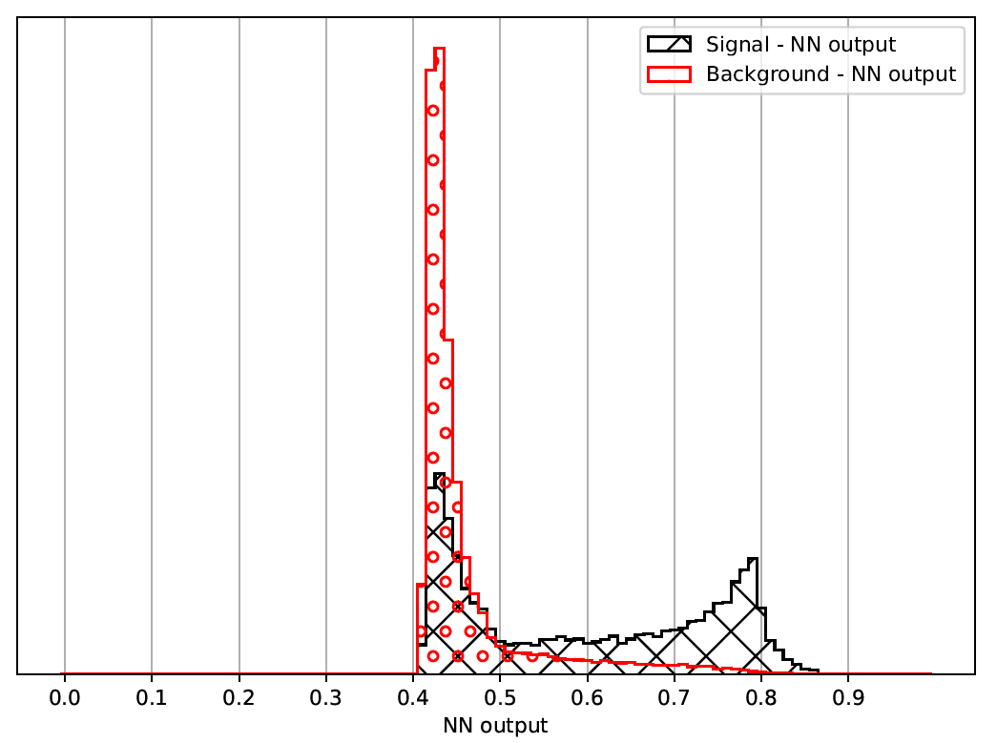

Slide 8
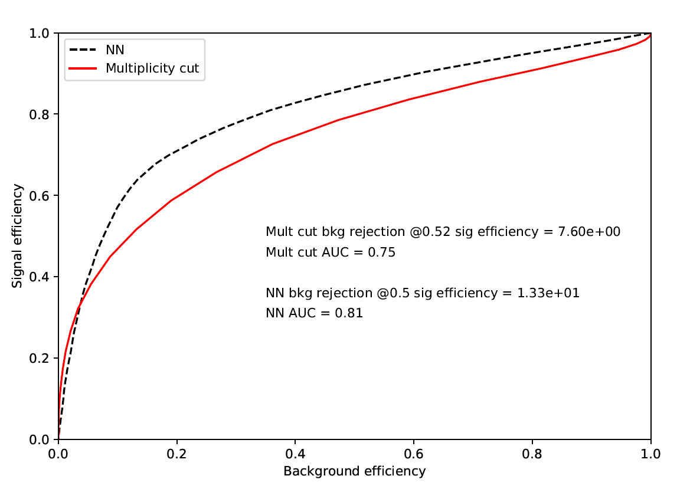
S
B
Frac1 = 73%
Frac2 = 37%
Model | LSTM
Signal fraction | 0.5
Multiplicity threshold | 15
Number of constituents | 40 (masked)

Slide 9
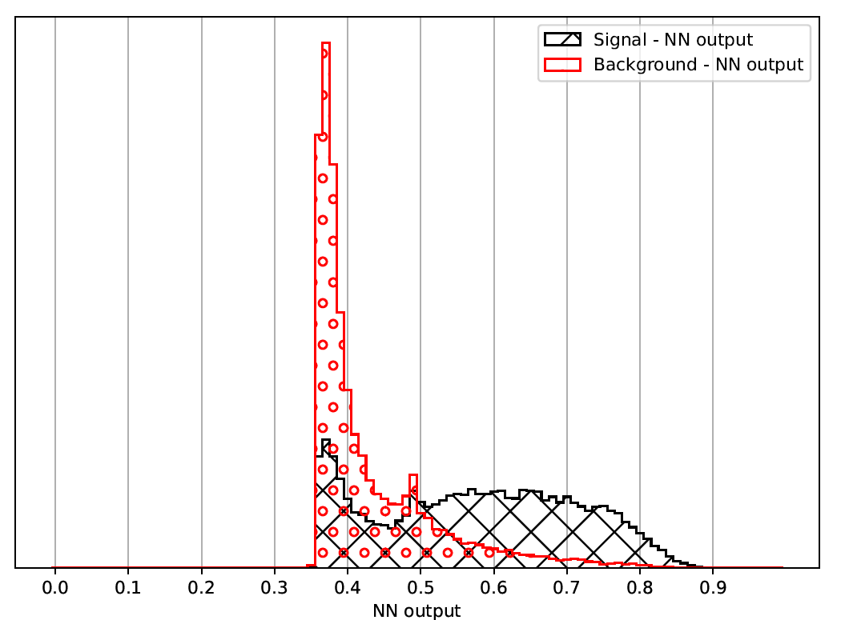
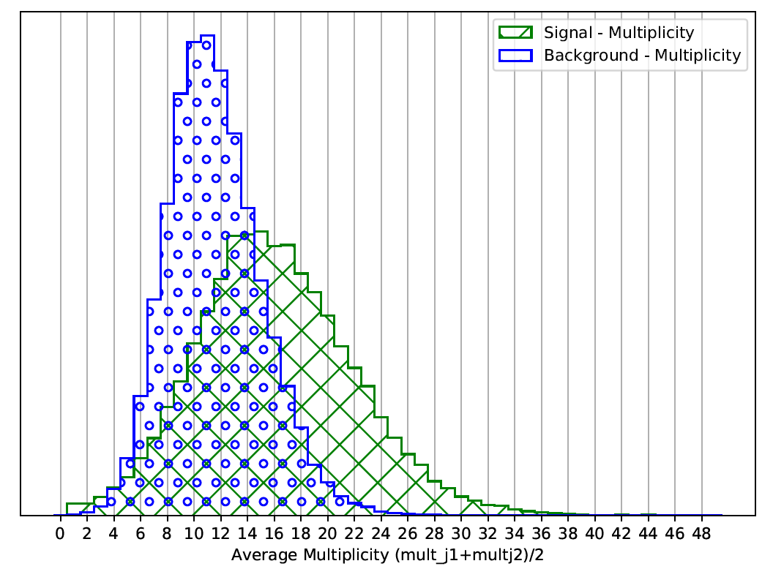

Slide 10

Correlation
jet1 and jet2 within event - $corr_{pearson}=0.24$
nn_out and j2 mult - $corr_{pearson}=0.68$
nn_out and j1 mult - $corr_{pearson}=0.31$

Slide 11
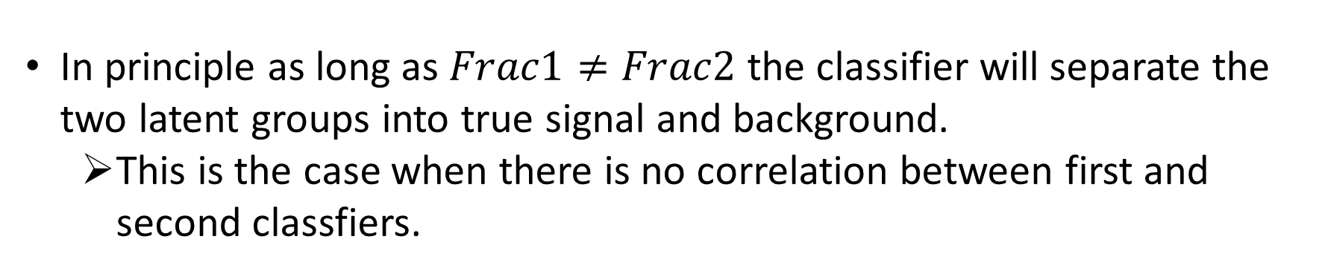
Discussion
In principle as long as $Frac1≠Frac2$ the classifier will separate the two latent groups into true signal and background.
This is the case when there is no correlation between first and second classfiers.

Slide 12
Future
Use autoencoder as first classifier.
Switch roles of jets to produce second TnT classifier.
Tune rinv and signal fraction for regime with bigger effect.

Slide 13
Details

Slide 14
Events generated
Background – b-jets
Signal – dark-jets
rinv = 0.5
ProbV = 0.5
Rest of dark – jets parameters

Slide 15
Event selection
Generation level PT cuts (500k generated)
dark-jets: [50, 150]
b-jets: [50, 150]
Post-generation cuts
dark-jets: [50, 150] (250k left)
b-jets: [50, 150] (250k left)
Distribution plots

Slide 16
Pre-processing
Generation level PT cuts (500k generated)
dark-jets: [50, 150]
b-jets: [50, 150]
Post-generation cuts
dark-jets: [50, 150] (250k left)
b-jets: [50, 150] (250k left)
Distribution plots

